Slide 1

Parent Forum
Parent Forum: Supporting Children Through Grief
Title:
"Helping Children Understand and Cope with Loss"

Slide 2

Parent Forum: Supporting Children Through Grief
"Helping Children Understand and Cope with Loss"
Objectives
Understand how children experience and express grief at different developmental stages.
Consider some practical strategies to support your child through bereavement or other forms of loss.
Gain confidence in talking openly about difficult emotions with their child.
Be aware of when and how to seek additional help and support.

Slide 3
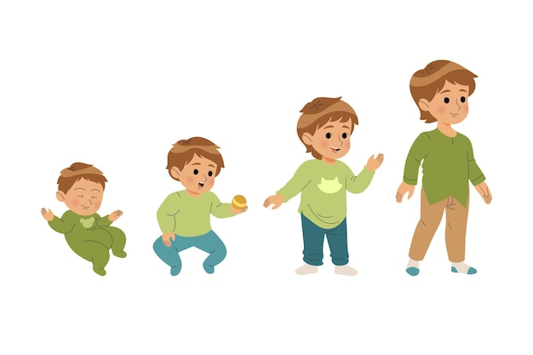
Understanding Children’s Grief
Children may revisit grief as they grow, understanding more over time.
Age-related reactions:
  Under 5: May not understand permanence of death, ask repetitive questions.
  5–7: Magical thinking, may blame themselves, need clear and honest explanations.
  8–11: More logical understanding but may hide feelings, anger, or guilt.

Slide 4

Understanding Children’s Grief
Forms of grief:
  Death of a loved one or pet
  Divorce or family separation
  Moving home or school
  Loss of friendships

Slide 5
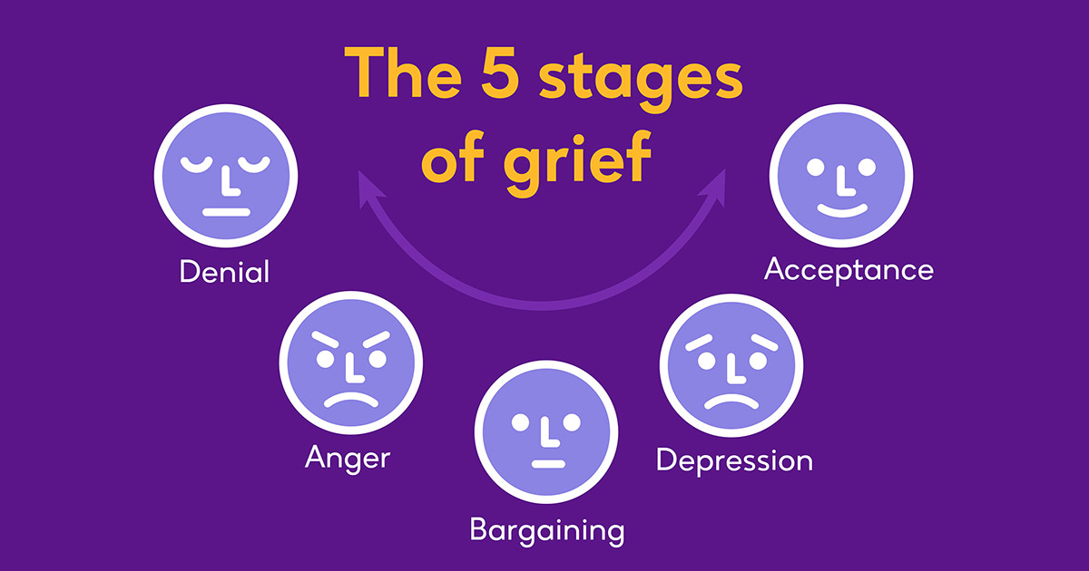

Slide 6



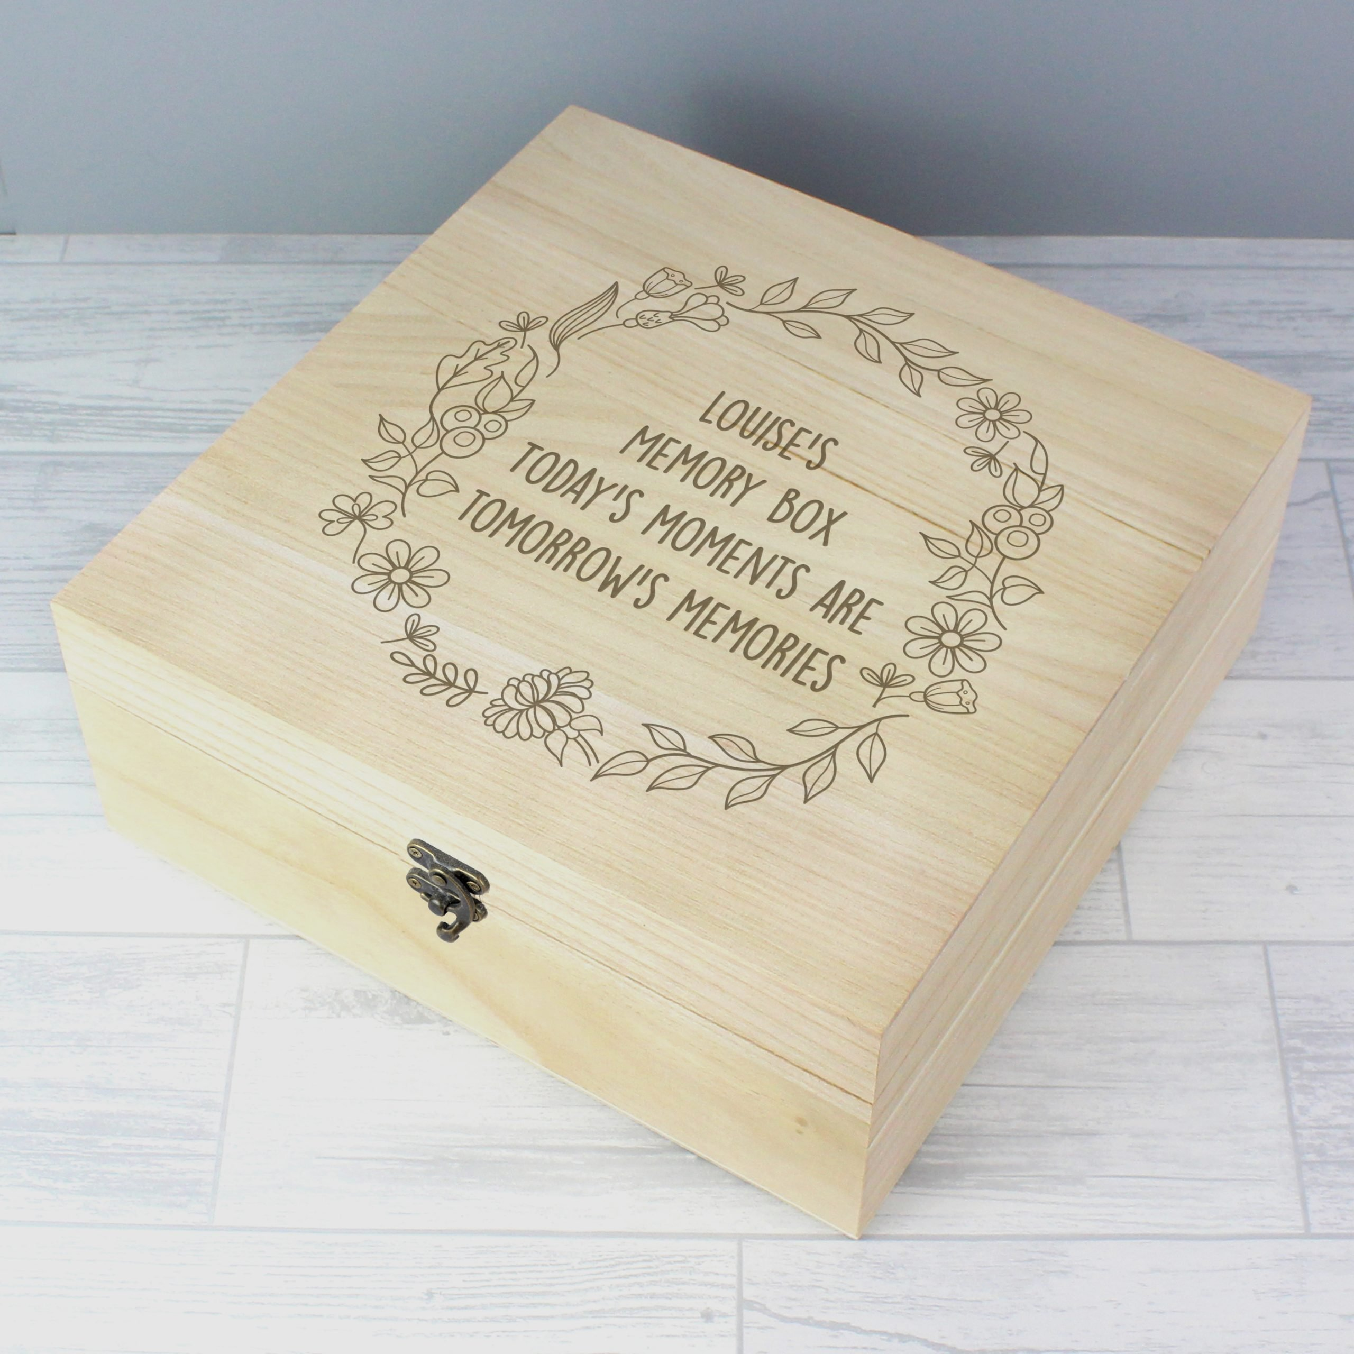
Practical Strategies for Parents
Open Communication: Use clear, honest language. Avoid euphemisms like "gone to sleep".
Routine and Stability: Maintain daily routines for security.
Creative Expression: Encourage drawing, writing, or play to process feelings.
Model Healthy Coping: Show that it’s okay to express emotions in an appropriate way.
Memory-Making Activities: Create a memory box, photo album, or special ritual.

Slide 7

Watch for Warning Signs:
  Persistent withdrawal
  Aggression or extreme anger
  Sleep disturbances or nightmares
  Drop in school performance
  Expressions of hopelessness

Slide 8
Where to Get Support
School
Bereavement charities (e.g. Winston’s Wish, Child Bereavement UK)
GP
CAMHS referral process
National helplines:
  Winston’s Wish Helpline: 08088 020 021
  Childline: 0800 1111

