Slide 1


EYFS – RECEPTION – SKILLS PROGRESSION DOCUMENT

Slide 2
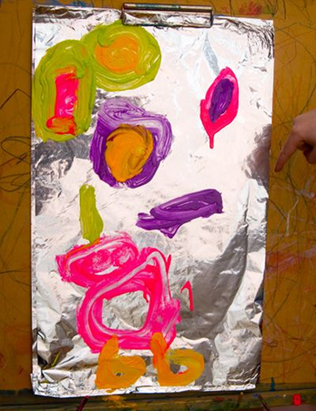
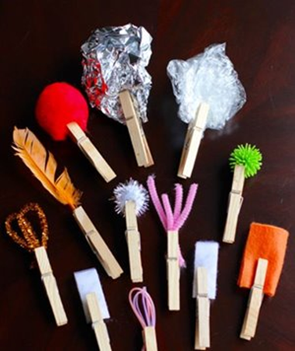
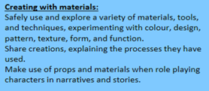
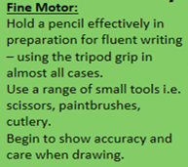
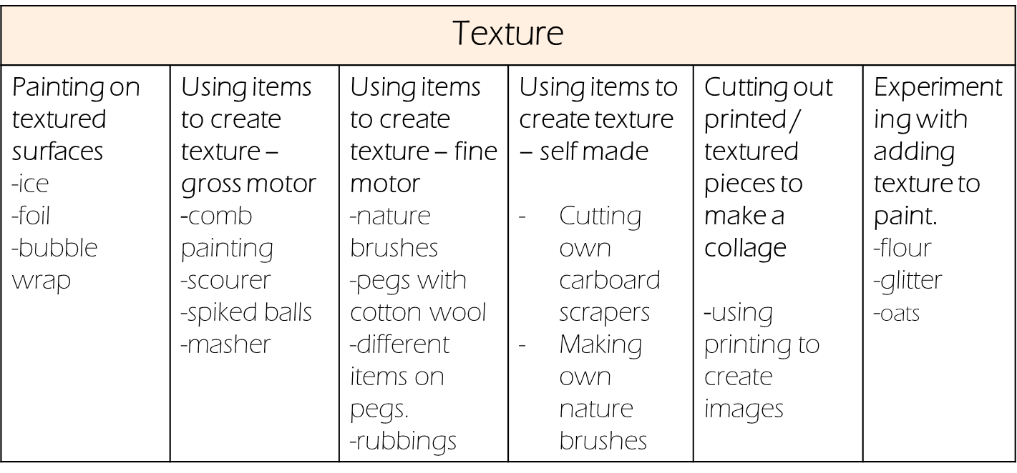
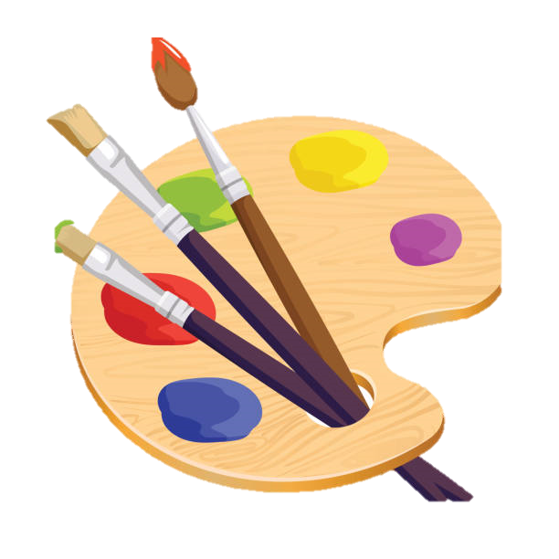
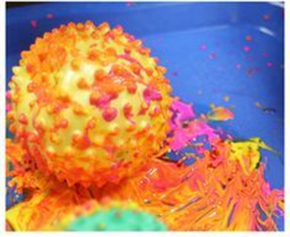
Expressive Arts and Design – Creating with materials

Slide 3
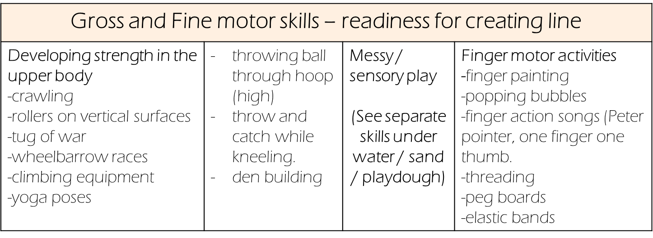
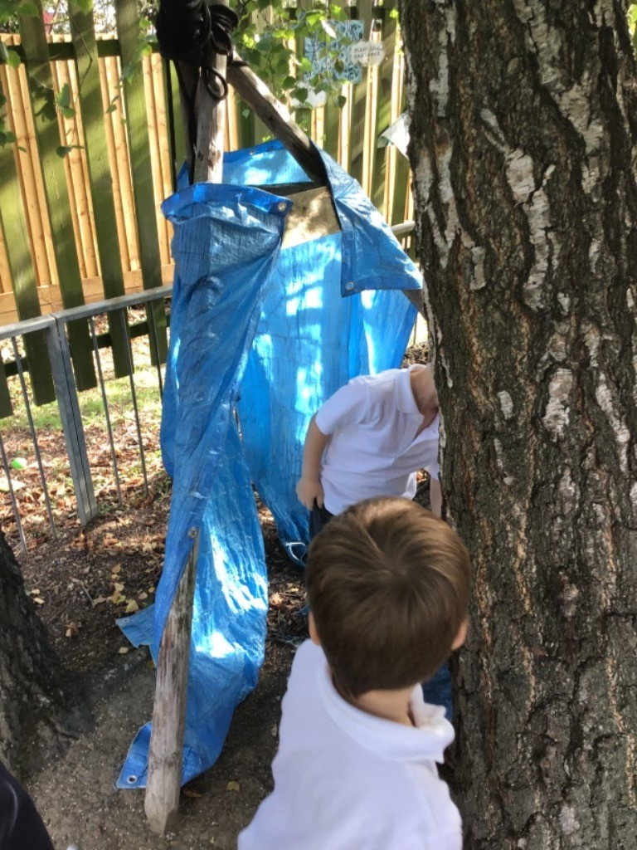
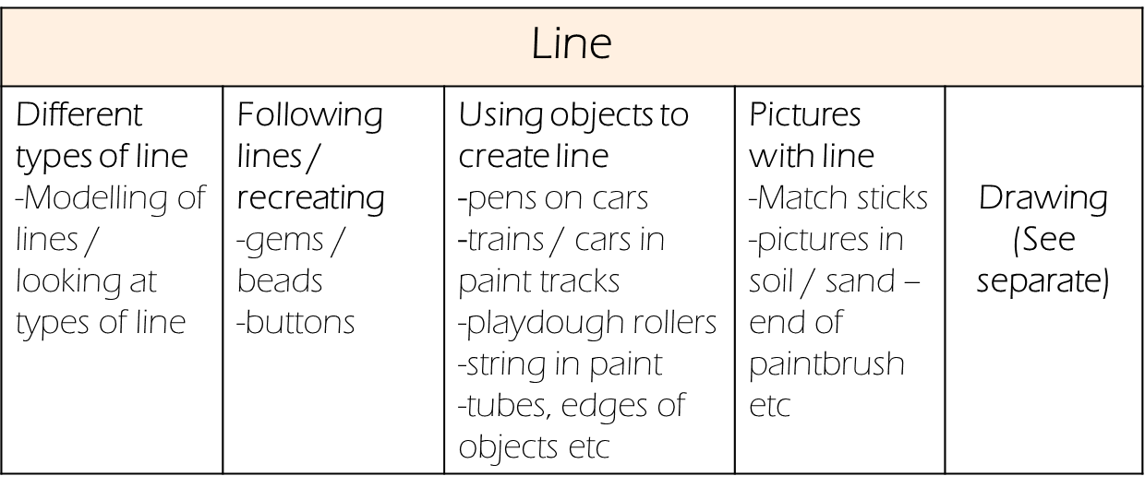
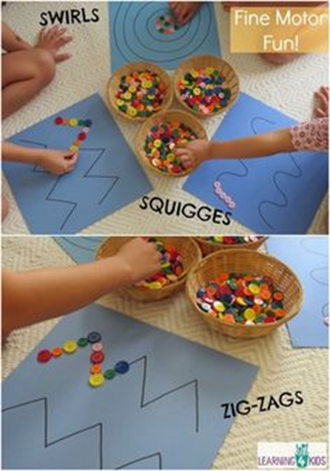

Slide 4
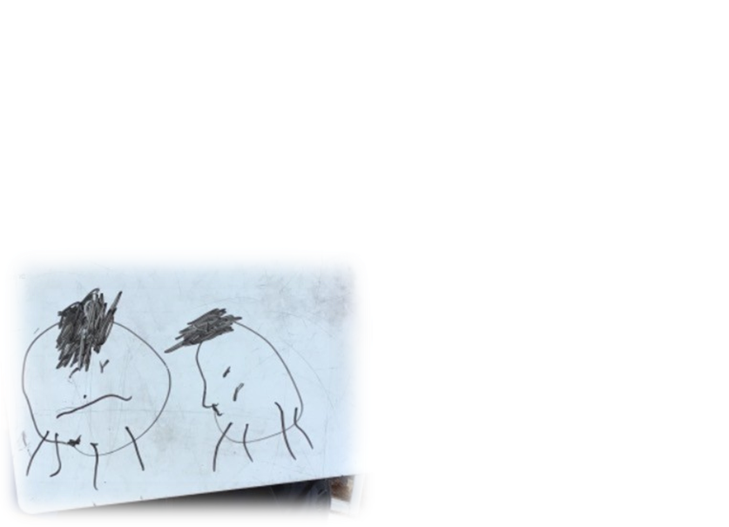
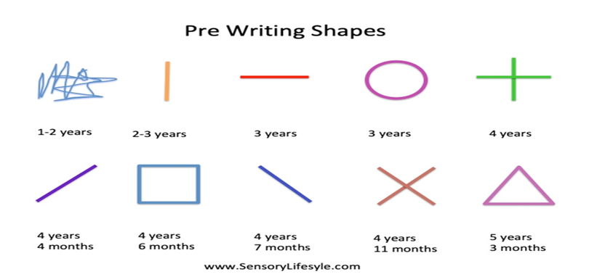
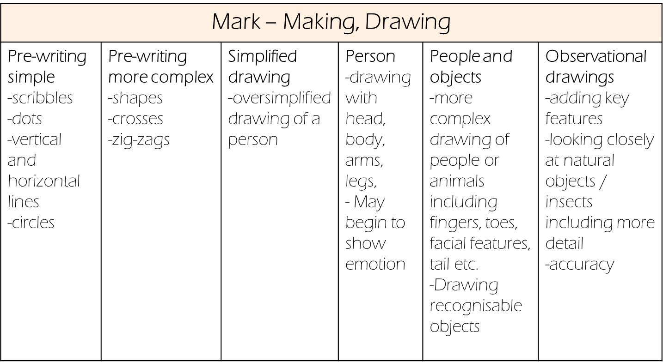


Slide 5

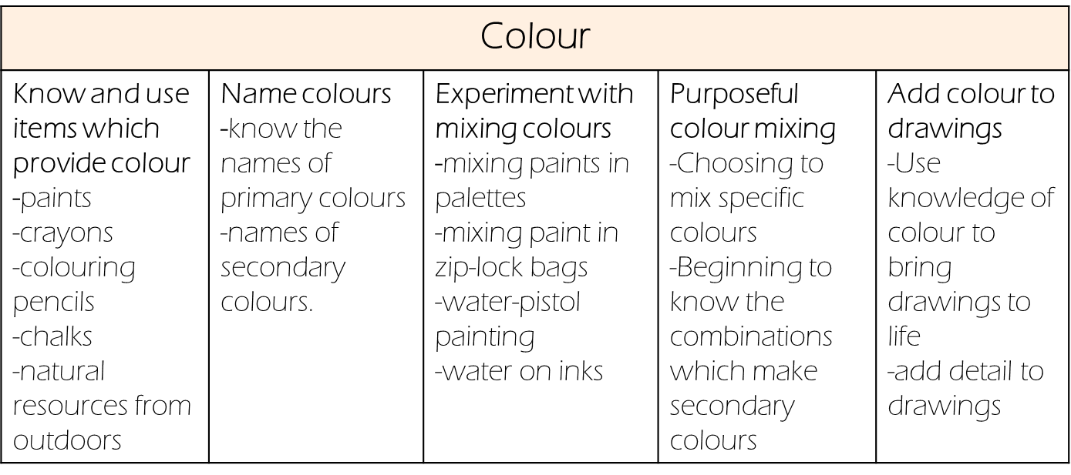
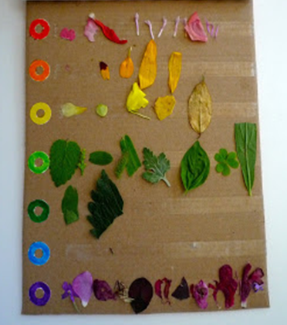
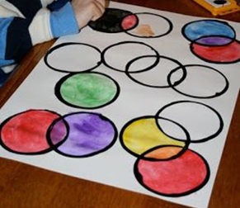
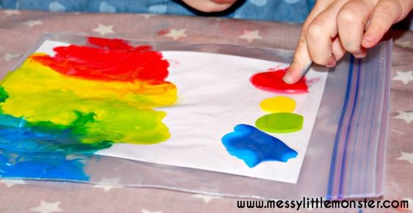

Slide 6
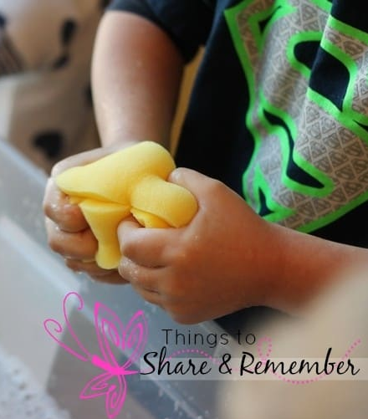
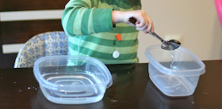

Physical development – Fine motor – Using a range of small tools
Squeezing
Squeezing liquid out -variety of containers -force required to get the liquid out. | Wringing out -sponges -cloths -clothes (dolls) -flannels | Squeezing to fill and eject water -Pipettes -Bath and water play toys which fill up and then eject water. -water pistoles -spray bottles | Squeezing for a purpose -To fill -Using glue, shampoo, soap etc.
Filling
Filling by submerging -containers and buckets by placing underwater | Filling using tools -using spoons -using ladles -deciding which tool to use dependent on size of container | Filling with accuracy -using the correct sized funnel -measuring jugs | Filling using a plunger -using a syringe to collect and transport water

Slide 7

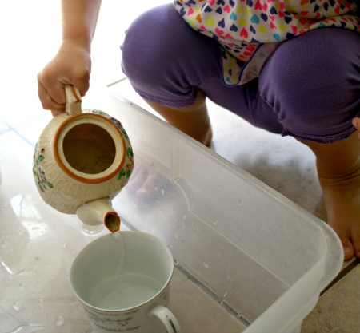
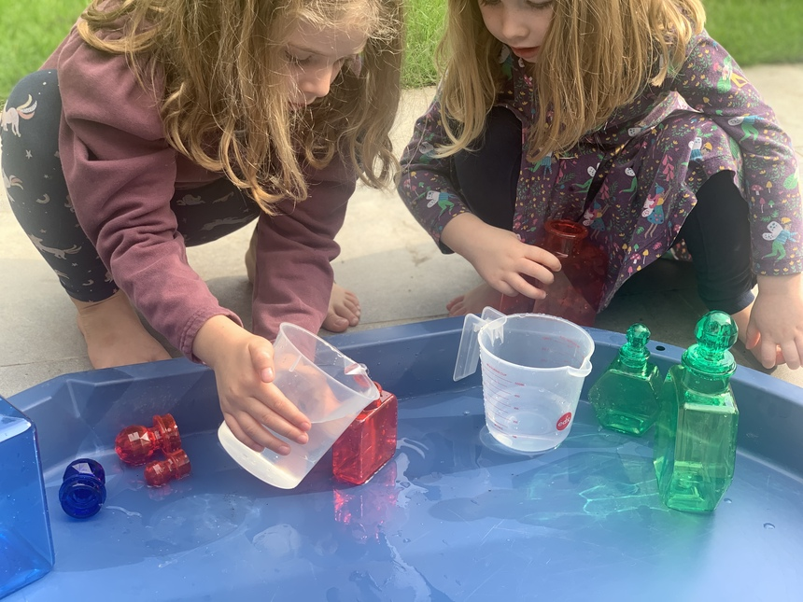
Pouring
Pouring by tipping -Pouring water from buckets, containers etc into large bowl or tray of water. | Pouring from one container to another -filling smaller containers with the liquid from a larger container -Exploring how much liquid containers can hold | Pouring for purpose -using a watering can to water plants -pouring a bucket of water down a drain -pouring water from cups into the sink -perfume making | Pouring to transport -putting water into guttering so it can travel -putting water into whistle tubes to move from one place to another | Pouring for purpose with accuracy -pouring water from a teapot to fit cups -pouring from a jug to make drinks -pouring sauce or gravy onto dinner (dining hall or home)

